Slide 1
402:Data Communications & Networks - II & Network Programming Using Linux (Theory)
DNS(Domain Name System)
Prepared by:-
Sheakha Belrich Tongper War Nongbri
Roll No-08
Skhembok Star Sohphoh
Roll No-04

Slide 2
Contents:
History of DNS.
Introduction to DNS.
Why we need to use names instead of IP numbers?
About DNS.
Fundamentals of DNS.
Purpose of DNS.
DNS Components.
Resource Record.
Security Issues.
The DNS Name Space.
The DNS Name Server.
References

Slide 3
History of DNS
The practice of using a name as a simpler, more memorable abstraction of a host's numerical address on a network dates back to the ARPANET era.
Back then however, a different system was used, as DNS was only invented in 1983.
With the older system, each computer on the network retrieved a file called HOSTS.TXT from a computer at SRI (now SRI International).
The HOSTS.TXT file mapped numerical addresses to names.

Slide 4
History of DNS
A hosts file still exists on most modern operating systems, either by default or through configuration.
Allows users to specify an IP address (eg. 192.0.34.166) to use for a hostname (eg. www.example.net) without checking DNS.
Nowadays, the hosts file serves primarily for troubleshooting DNS errors or for mapping local addresses to more organic names .
Systems based on a hosts file have inherent limitations.
The obvious requirement that every time a given computer's address changed, every computer that seeks to communicate with it would need an update to its hosts file.

Slide 5
Introduction to DNS
DNS replaces the Hosts file with a distributed database that implements a hierarchical naming system.
This naming system allows for growth on the Internet and the creation of names that are unique throughout the Internet.
Domain Name Servers (DNS) are the Internet's equivalent of a phone book
They maintain a directory of domain names and translate them to Internet Protocol (IP) addresses.
This is necessary because, although domain names are easy for people to remember, computers or machines, access websites based on IP addresses.
A domain name is the human-friendly name that we are used to associating with an internet resource.

Slide 6
Introduction to DNS
For instance, "google.com" is a domain name. Some people will say that the "google" portion is the domain, but we can generally refer to the combined form as the domain name.
The URL "google.com" is associated with the servers owned by Google Inc.
The domain name system allows us to reach the Google servers when we type "google.com" into our browsers.
A client-server application maps the host names into their corresponding IP addresses.
Mapping host names into their corresponding IP addresses is called name resolution or name translation or name mapping or Address Resolution .

Slide 7
Why we need to use names instead of IP numbers?
IP addresses are difficult to remember .
IP addresses can change.
Problem: Network only understands numeric addresses .
Solution:
Use alphanumeric names to refer to hosts.
Add a distributed, hierarchical protocol (called DNS) to map between alphanumeric host names and IP addresses.

Slide 8
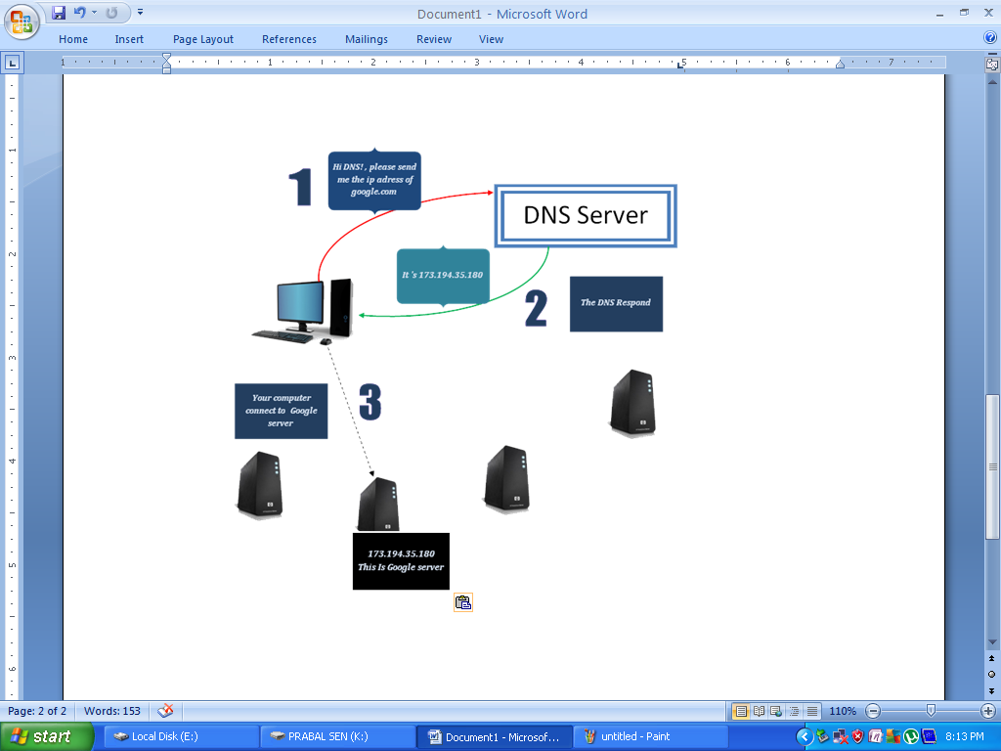
About DNS
TCP/IP protocols use the IP address ,which is numeric addresses.
Internet needs to have a directory system that can map a name to an address.
Central directory system cannot hold all the mapping, so a solution is to distribute the information .
The host that needs mapping can contact the closest computer holding the needed information. This method is used by DNS.

Slide 9
Fundamentals of DNS
The DNS not only supports host name to network address resolution, known as forward resolution, but it also supports network address to host name resolution, known as inverse resolution.
Its ability to map human memorable system names into computer network numerical addresses, its distributed nature, and its robustness, the DNS has evolved into a critical component of the Internet.
Without it, the only way to reach other computers on the Internet is to use the numerical network address.
Using IP addresses to connect to remote computer systems is not a very user-friendly representation of a system’s location on the Internet.
Thus the DNS is heavily relied upon to retrieve an IP address.

Slide 10
Purpose of DNS
User
1
Host name
DNS Server
File Transfer client
Host name
DNS client
3
Query
Application Layer
2
5
Response
4
IP address
6
IP address
Network Layer

Slide 11
Purpose Of DNS
TCP/IP uses a DNS client and DNS server to map a name to an address.
User wants to use a file transfer client to access the corresponding file transfer server running on a remote host.
NOTE:
Connection between DNS client and DNS server need at least 2 connections.
The first is for mapping the name to an IP address.
The second is for transferring files.

Slide 12
Purpose Of DNS
TCP/IP suite needs the IP address of the file transfer server to make the connection.
Following Six steps map the host name to IP address:
The user passes the host name to the file transfer client.
The file transfer client passes the host name to the DNS client.
Each computer, after being booted, knows the address of one DNS server. The DNS client sends a message to a DNS server with a query that gives the file transfer server name using the known IP address of the DNS server.
The DNS server responds with the IP address of the desired file transfer server.
The DNS server passes the IP address to the file transfer client .
The file transfer client now uses the received IP address to access the file transfer server.

Slide 13
DNS Components
The DNS has three major components, the database, the server, and the client .
The database is a distributed database and is comprised of the Domain Name Space, which is essentially the DNS tree, and the Resource Records (RRs) that define the domain names within the Domain Name Space.
The server is commonly referred to as a name server.
Name servers are typically responsible for managing some portion of the Domain Name Space and for assisting clients in finding information within the DNS tree .
Name servers are authoritative for the domains in which they are responsible.
They can also serve as a delegation point to identify other name servers that have authority over sub domains within a given domain.

Slide 14
DNS Components
The client component of the DNS typically contains software routines, known as functions, which are responsible for requesting information from the Domain Name Space on behalf of an application.
These functions are bundled together into a software library that is commonly referred to as the resolver library.
For this reason, clients are often called resolvers.
The resolver library functions are responsible for sending a query to a name server requesting information concerning a DNS name and returning the answer to the query back to the requestor.

Slide 15
Resource Record
A Resource Record (RR) is the basic data element in the domain name system.
Resource Records (Records) contains the domain name and IP address mappings for computers.
All Resource Records have a Time To Live (TTL), specifying the number of seconds other DNS servers and applications are allowed to cache the Record.
Sets of information in the DNS database that can be used to process client queries.
Each DNS server contains the resource records it needs to answer queries for the portion of the DNS namespace for which it is authoritative (A DNS server is authoritative for a contiguous portion of the DNS namespace if it contains information about that portion of the namespace.)

Slide 16
Resource Record
The RR data found on the name server that makes up a domain is commonly referred to as zone information.
Thus, name servers have zones of authority.
A single zone can either be a forward zone (i.e., zone information that pertains to a given domain) or an inverse zone (i.e., zone information that maps IP addresses into DNS host names).
DNS allows more than one name server per zone, but only one name server can be the primary server for the zone.
Primary servers are where the actual changes to the data for a zone take place.
All the other name servers for a zone basically maintain copies of the primary server’s database for the zone.
These servers are commonly referred to as secondary servers.

Slide 17
Resource Record
A DNS RR has 6 fields:
NAME.
TYPE.
CLASS.
TTL.
RD Length.
RDATA.
The NAME field holds the DNS name, also referred to as the owner name, to which the RR belongs.
The TYPE field is the TYPE of RR. This field is necessary because it is not uncommon for a DNS name to have more than one type of RR.
The more common types of RR are found in Table 1.

Slide 18
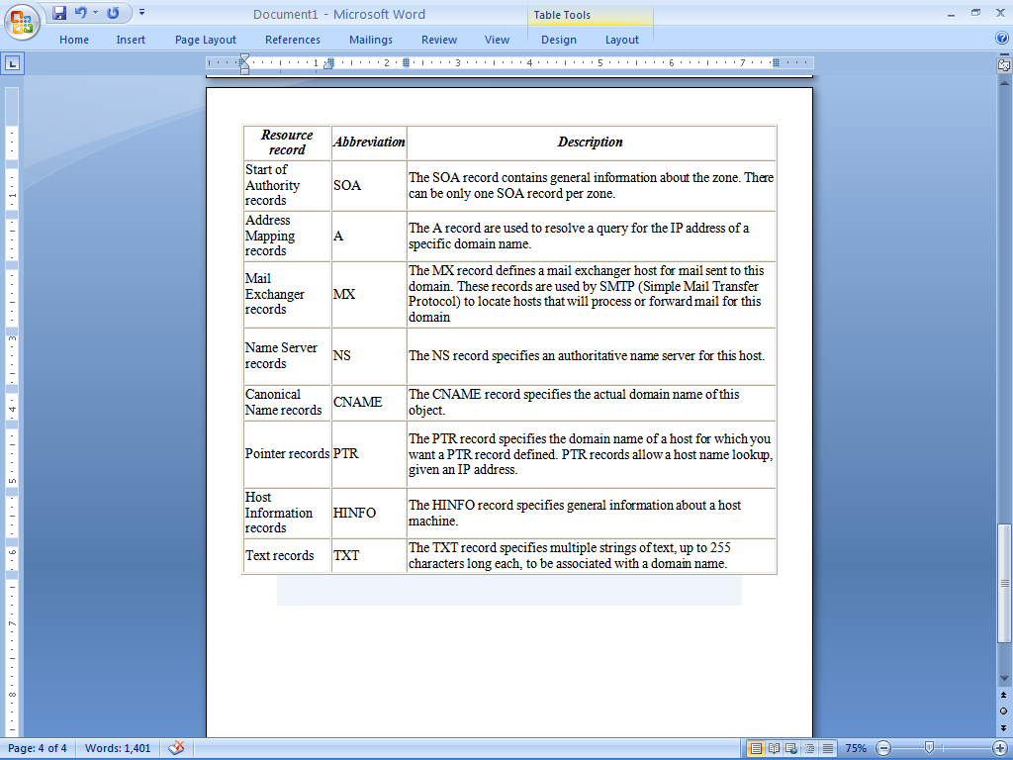
Common DNS Resource Records :

Slide 19
Security Issues
Some domain names can spoof other, similar-looking domain names.
For example, "paypal.com" and "paypa1.com" are different names, yet users may be unable to tell the difference when the user's typeface(font) does not clearly differentiate the letter l and the number 1.
DNS responses are traditionally not cryptographically signed, leading to many attack possibilities:
Cache Poisoning
Denial of Service (DoS)
Masquerading
Client Flooding
Information Leakage
Compromise of DNS server’s authoritative data

Slide 20
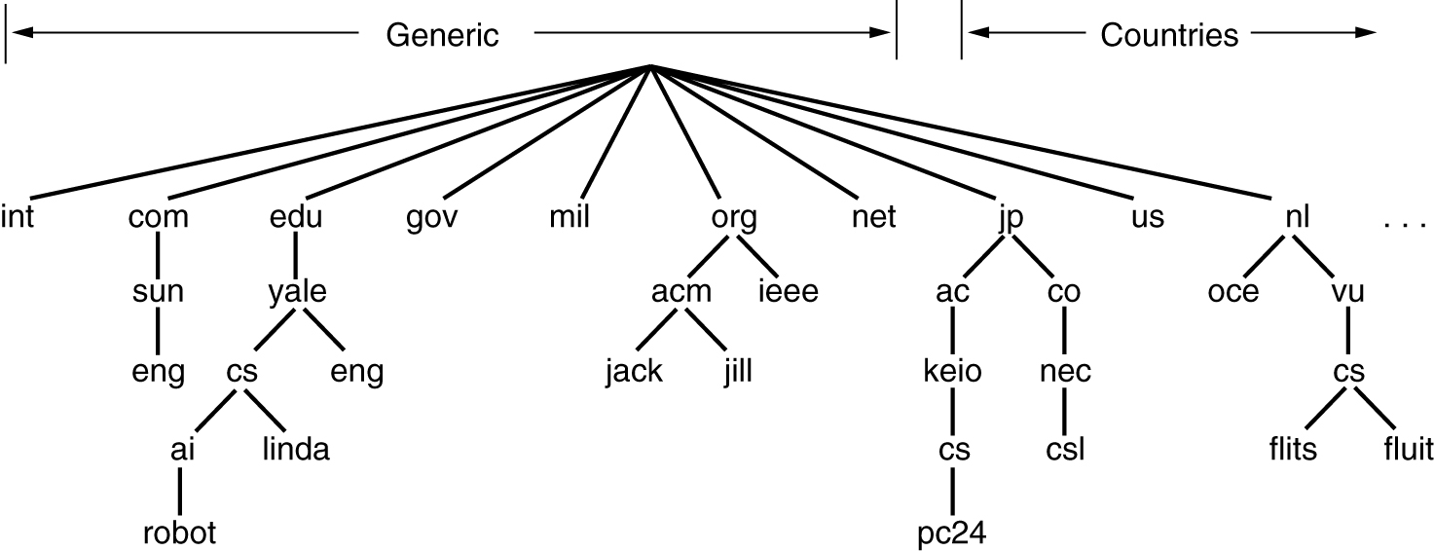
The DNS Name Space
The Internet is divided into over 200 top-level domains, where each domain covers many hosts.
The top-level domains come in two flavors:-
Generic and
Countries.
This is shown in the following figure:-
A portion of the Internet domain name space.

Slide 21
The DNS Name Space
The original generic domains were com (commercial), edu (educational institutions), gov (the U.S. Federal Government), int (certain international organizations), mil (the U.S. armed forces), net (network providers), and org (nonprofit organizations).
The country domains include one entry for every country, as defined in ISO 3166.
Other new generic domains added later include biz (businesses), info (information), name (people's names) pro (professions), aero (aerospace industry), coop (co-operatives), and museum (museums).

Slide 22
The DNS Name Space
Each domain is named by the path upward from it to the (unnamed) root.
Domain names can be either absolute or relative. An absolute domain name always ends with a period (e.g., eng.sun.com.), whereas a relative one does not.
Domain names are case insensitive, so edu, Edu, and EDU mean the same thing. Component names can be up to 63 characters long, and full path names must not exceed 255 characters.
Each domain controls how it allocates the domain under it.
To create a new domain, permission is required of the domain in which it will be included.

Slide 23
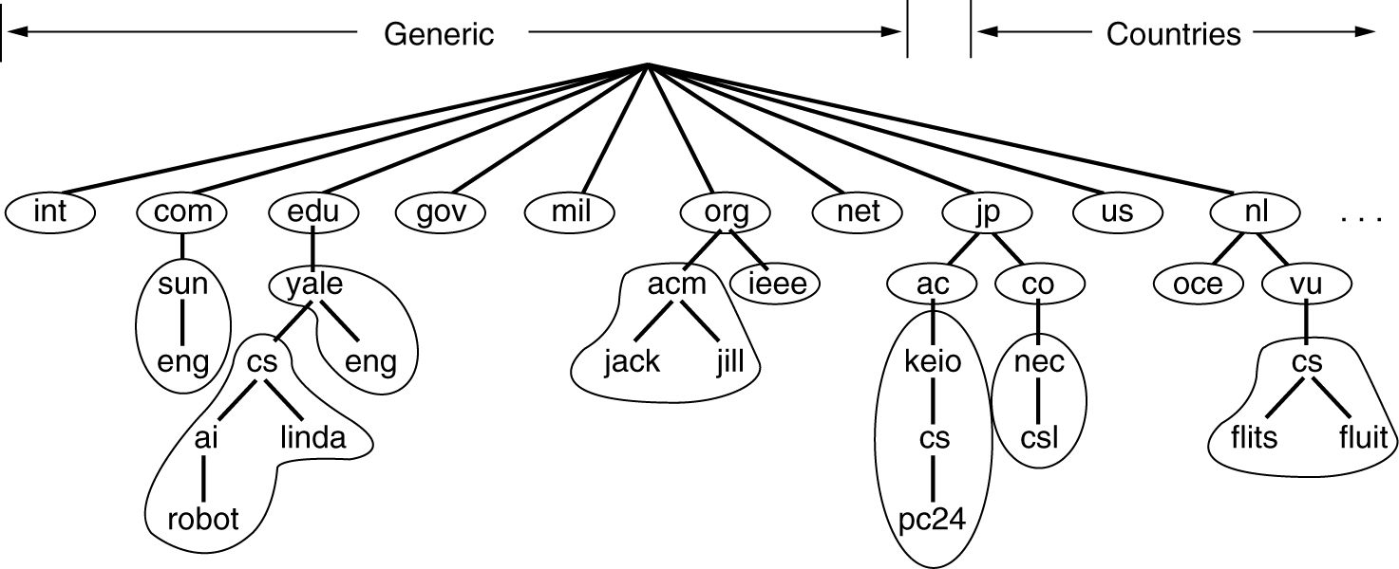
The DNS Name Server
In theory at least, a single name server could contain the entire DNS database and respond to all queries about it. In practice this server would be so overloaded as to be useless.
To avoid this problem, of having only one source of information, the DNS name space is divided into non-overlapping zones as shown in the figure:-
Part of the DNS name space divided into zones(which are circled)

Slide 24
The DNS Name Sever
Each zone is associated with one or more name servers.
These are hosts that hold the database for the zone.
Normally a zone will have one primary name server, which gets its information from a file on its disk, and one or more secondary name servers, which gets their information from the primary name server.

Slide 25
The DNS Name Server
The process of looking up a name and finding an address is called name resolution.
An authoritative record is one that comes from the authority that manages the record and is thus always correct.
Authoritative records are in contrast to cached records, which may be out of date.
Root name servers are servers that have information about each top-level domain.

Slide 26
REFERENCES
http://www.networksolutions.com/support/what-is-a-domain-name-server-dns-and-how-does-it-work
https://technet.microsoft.com/en-us/library/cc958965.aspx#mainSection
http://compsec101.antibozo.net/papers/dnssec/dnssec.html
https://www.slideshare.net/chinmaynj/presentation-on-domain-name-system
Computer Networks 4th Edition – Andrew S.Tanenbaum

